Slide 1
Cover Time of Simple Random Walks on a Graph
Probability for Data Science – Master’s Degree in Data Science – 2023/2024
Federico Vaona

Slide 2
Introduction
A Simple Random Walk on a graph is a sequence of movements from one vertex to another where at each
step the next vertex is chosen uniformly at random from the neighbors of the current one. Project Objective: This project investigates the cover time for both single and multiple random walks on a complete graph. The aim is to investigate how running many random walks in parallel yields a speed-up in the cover time.
The Cover Time of a random walk is the expected time to visit every node in a graph.

Slide 3
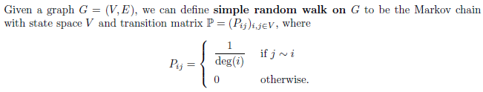
Random Walk On Graphs
Complete Graph: A graph where every pair of distinct vertices is connected by a unique edge.
Deg(i) = the number of neighbors of the vertex i

Slide 4
Implementation
Libraries
Networkx: Used to create and manipulate complete graphs, essential for modeling the structure on which to perform the random walks.
Scipy: Used for optimization and fitting of collected data, crucial for comparing empirical results with theoretical models.
Definition of Parameters
I chose to reduce the number of nodes to N= 50 and the number of simulations to M=10 and M=20 for computational efficiency reasons.
These values allow for obtaining indicative results within a reasonable timeframe. However, fitting to theoretical models is certainly less precise, but the general trends should remain representative.

Slide 5
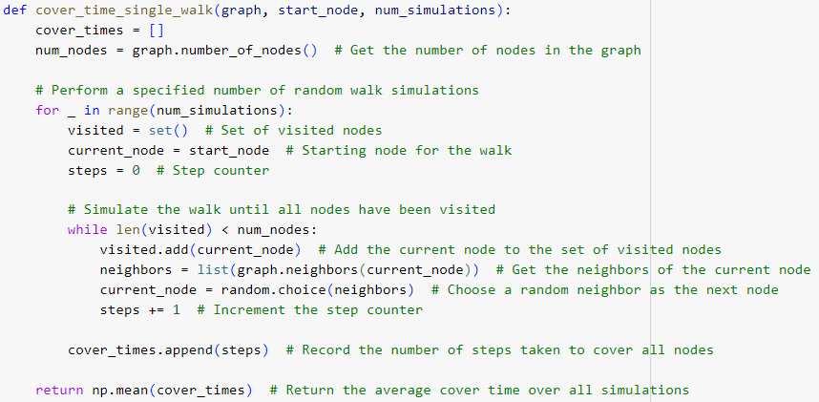
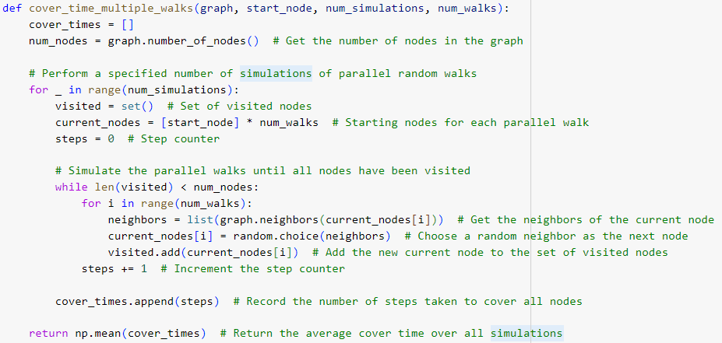
Codes
Single Walk Cover Time Function
Multiple Walk Cover Time Function

Slide 6
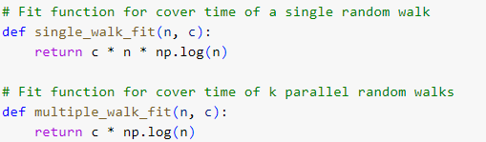
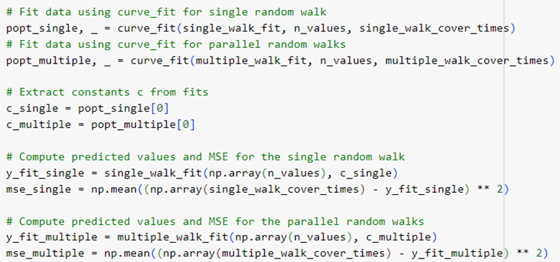
Codes
Theoretical function cn log(n) e c log(n)
Computation of MSE and the optimal parameter c

Slide 7
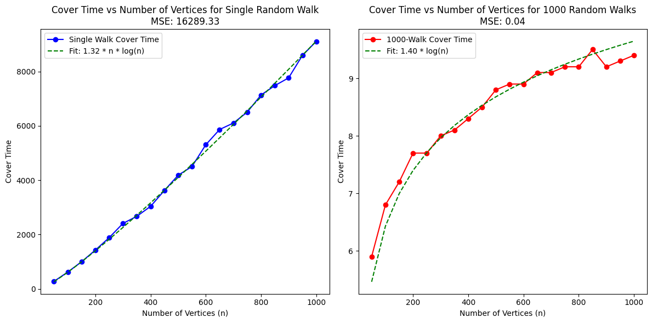
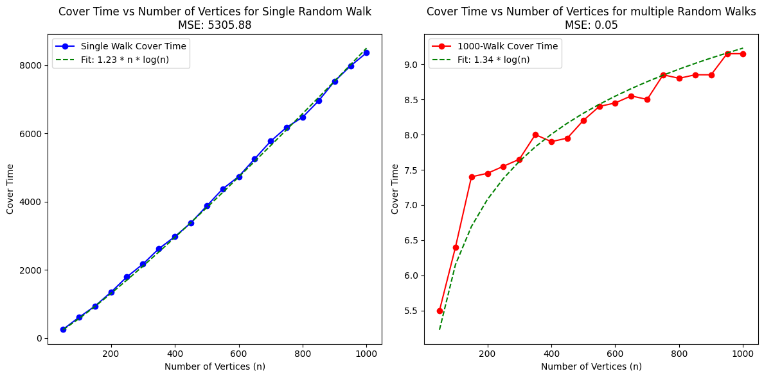
Analysis And Results
Single Random Walk:
The theoretical fit cn log(n) follows the observed data trend, suggesting that the cover times behave as theoretically expected. Increasing the number of simulations from 10 to 20 significantly reduced the MSE, indicating improved accuracy. The discrepancy measured by the MSE was significantly reduced by increasing the number of simulations, though further simulations could potentially yield even better accuracy.
Plot with number of simulations M = 10
Plot with number of simulations M = 20

Slide 8
Analysis And Results
Parallel Random Walks:
The theoretical fit c log(n) adheres perfectly to the observed data, confirming that the cover times for parallel walks align with theoretical expectations. The MSE values are extremely low, indicating high precision.
Plot with number of simulations M = 10
Plot with number of simulations M = 20

Slide 9
Conclusion
Single Random Walk:
The observed trend is consistent with the theoretical formula c⋅n⋅log⁡(n)
The high MSE is due to the very high cover time and the significant variability in the simulation results.
Parallel Random Walks:
The results demonstrate the expected behavior c⋅log⁡(n) with very low MSE values, demonstrating the expected behavior.
The low MSE despite the low number of simulation is due to the greater efficiency of parallel walks, which reduces the cover time and variability in results.
Future Actions:
Further increase the number of simulations for the single random walk to improve precision and reduce the MSE.
Explore other types of graphs and configurations to verify the generalizability of the obtained results.

